Slide 1

Replication: Personal Economic Shocks and Public Opposition to Unauthorized Immigration
Original authors:
Daniel J. Hopkins
Yotam Margalit
Omer Solodoch
Replication by:
Shekhar Kedia
Module: Applied Statistics – II
Faculty: Jeffrey Ziegler
Programme: MSc. ASDS

Slide 2

About the research:
Aim: to see if COVID-19 affected 2020 US presidential vote choice
Media and academic discourse favoured Trump
Management of COVID-19 led to the negative sentiment
Dataset: 2020 Cooperative Election Study (CES) survey data administered by YouGov
Research question:
Did exposure to COVID-19 impact vote choice in the 2020 presidential election?
Key findings:
Trump’s vote share decreased because of COVID-19.
However, no evidence that Joe Biden loses election when no voter reports exposure to COVID-19 cases and deaths.

Slide 3

Replication
Authors have done a great job in understanding the impact of COVID-19 exposure on voting choice but the exposure is a binary variable.
Authors have tried to understand impact of three different types of COVID-19 exposure:
Respondent has been diagnosed with COVID-19
Respondent knows someone who has been diagnosed with COVID-19
Respondent knows someone who died from COVID-19
Contribution: Create a scale variable (count no. of COVID-19 exposure) depending on degree of exposure (zero, one, two or all three) and see if there is any differential impact on voting choice.
Hypothesis to test:
H0 (null): Higher exposure to COVID-19 has no impact on voting choice
H1 (alternate): Higher exposure to COVID-19 affects voting choice.

Slide 4
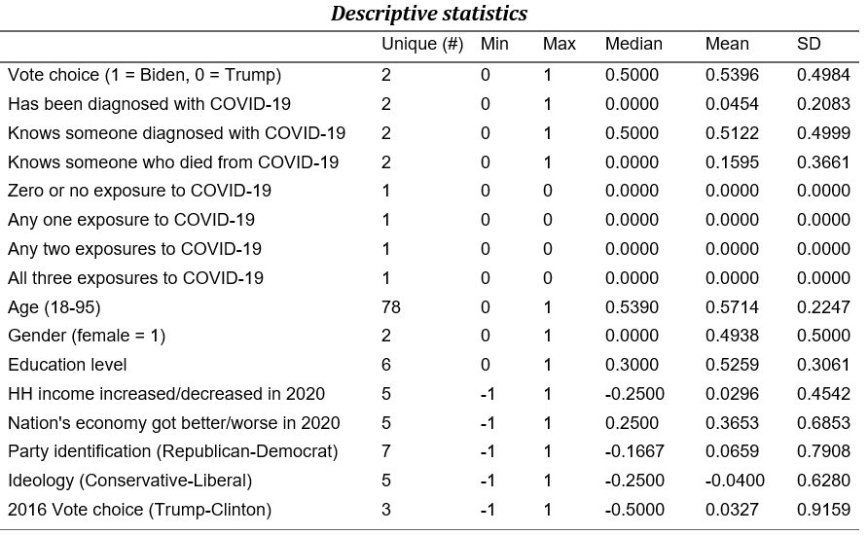
Descriptive summary

Slide 5
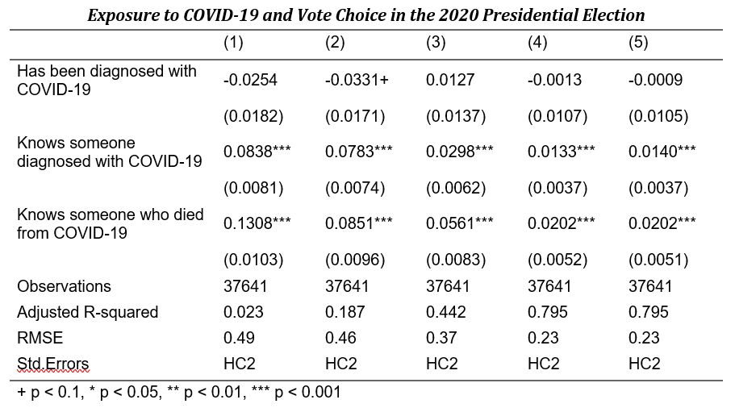
Linear regression model output (author)
Increase in percentage of vote choice for Biden with exposure to COVID19 cases and deaths

Slide 6
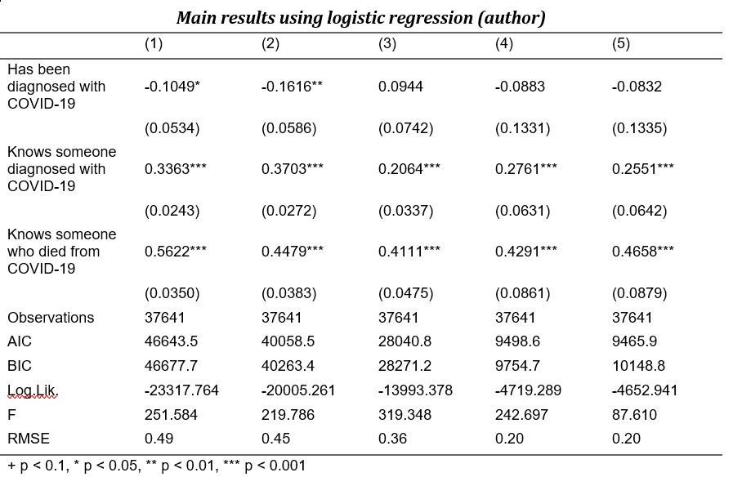
Logistic regression model output (author)
Increase in log odds of vote choice for Biden with exposure to COVID19 cases and deaths

Slide 7
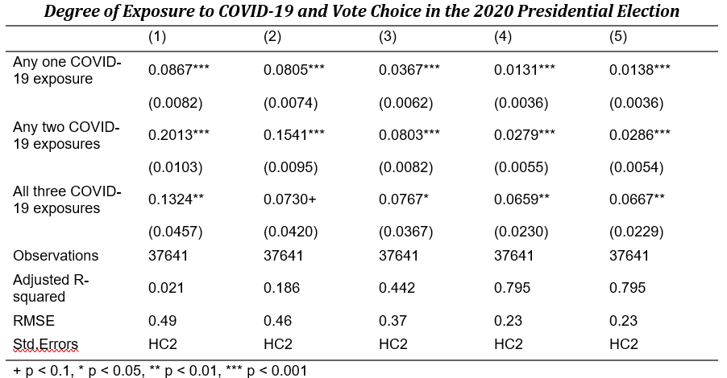
Linear regression model output (contribution)
Higher degree of COVID-19 exposure is associated with higher increase in percentage of vote choice for Biden.

Slide 8
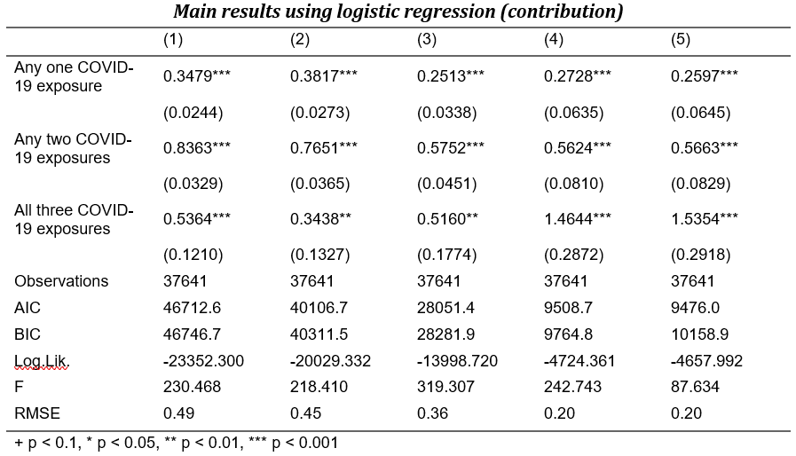
Logistic regression model output (contribution)
Higher degree of COVID-19 exposure is associated with higher increase in log odds of vote choice for Biden.

Slide 9

Interpretation
Original research established exposure to COVID-19 was associated with increase in vote choice for Biden.
Linear regression output (full model) show 1.4% increase in vote share for Biden if respondent knows someone who was diagnosed with COVID-19 and 2% increase if respondent knows someone who died from COVID-19
Logistic regression output produced by the author shows similar trend in increase of log odds for vote choice for Biden
As part of my contribution, created a scale variable to count degree/no. of COVID-19 exposure (0/1/2/3) and see how differential exposure impact vote choice towards Biden.
Linear regression (Table 2) show higher exposure to COVID-19 is associated with higher percentage increase in vote choice for Biden
Increase by 1.3%, 2.8% and 6.6% for 1, 2 and 3 degree of exposure respectively (for full model).
Logistic regression (Table 4) show higher exposure to COVID-19 is associated with higher log odds increase in vote choice for Biden
Increase by 0.25, 0.56 and 1.53 log odds for 1, 2 and 3 degree of exposure respectively (for full model).

Slide 10
Thank you

